Slide 1
Task 3.2 Report
Name: Abhishek Shashikant Chaphekar
Vulnerability Name: SQL Injection
Ethical Hacking Internship

Slide 2
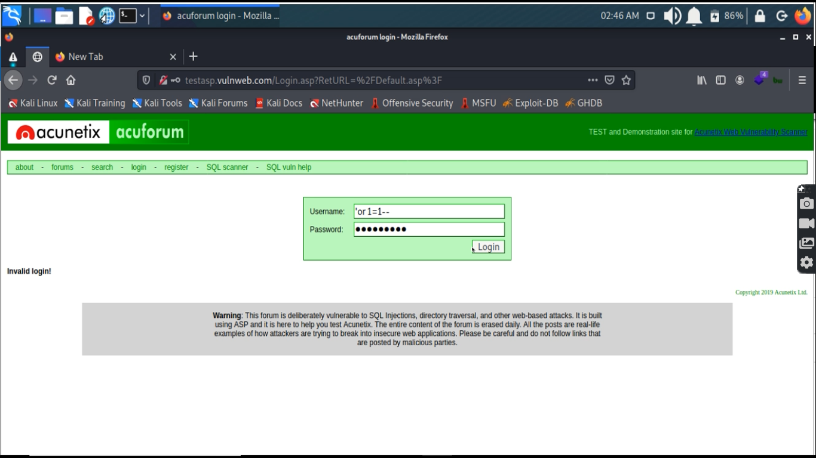
Screenshot 1

Slide 3
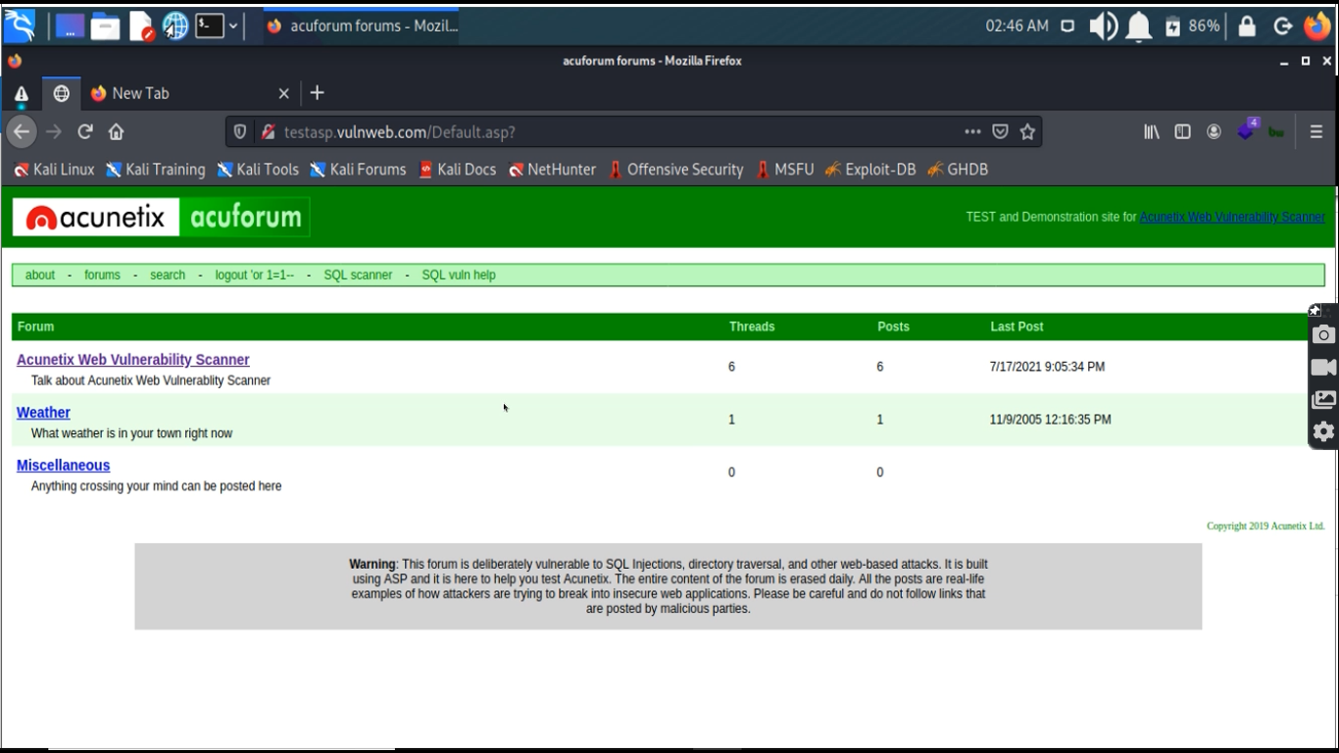
Screenshot 2

Slide 4
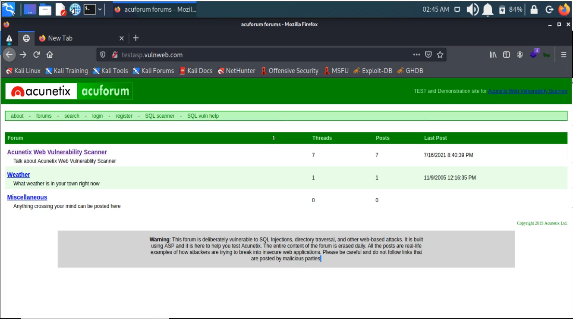
POC Video

Slide 5
Vulnerability Name: SQL Injection
URL: http://testasp.vulnweb.com/
Severity: Critical
Reported By: Abhishek Shashikant Chaphekar
Reported On: 17/07/2021
Description:
SQL injection is a web security vulnerability that allows an attacker to interfere with the queries that an application makes to its database. It generally allows an attacker to view data that they are not normally able to retrieve. This might include data belonging to other users, or any other data that the application itself is able to access. In many cases, an attacker can modify or delete this data, causing persistent changes to the application's content or behavior.
In some situations, an attacker can escalate an SQL injection attack to compromise the underlying server or other back-end infrastructure, or perform a denial-of-service attack.

Slide 6
Steps to Reproduce:
1) Click on login tab
2) Inject following payload in username field: 'or 1=1--
3) Type any random password
4) Click on login
5) Authentication is bypassed
Impact:
A successful SQL injection attack can result in unauthorized access to sensitive data, such as passwords, credit card details, or personal user information. Many high-profile data breaches in recent years have been the result of SQL injection attacks, leading to reputational damage and regulatory fines. In some cases, an attacker can obtain a persistent backdoor into an organization's systems, leading to a long-term compromise that can go unnoticed for an extended period.
Solution:
With user input channels being the main vector for such attacks, the best approach is controlling and vetting user input to watch for attack patterns. Developers can also avoid vulnerabilities by applying the following main prevention methods:
Input Validation
Parametrized Queries
Stored Procedures
Avoiding Administrative Privileges
Web Application Firewall

